Slide 1

Evaluating India's Energy Transition
A Comparative Analysis of Coal and Nuclear Power for Sustainable Development

Slide 2
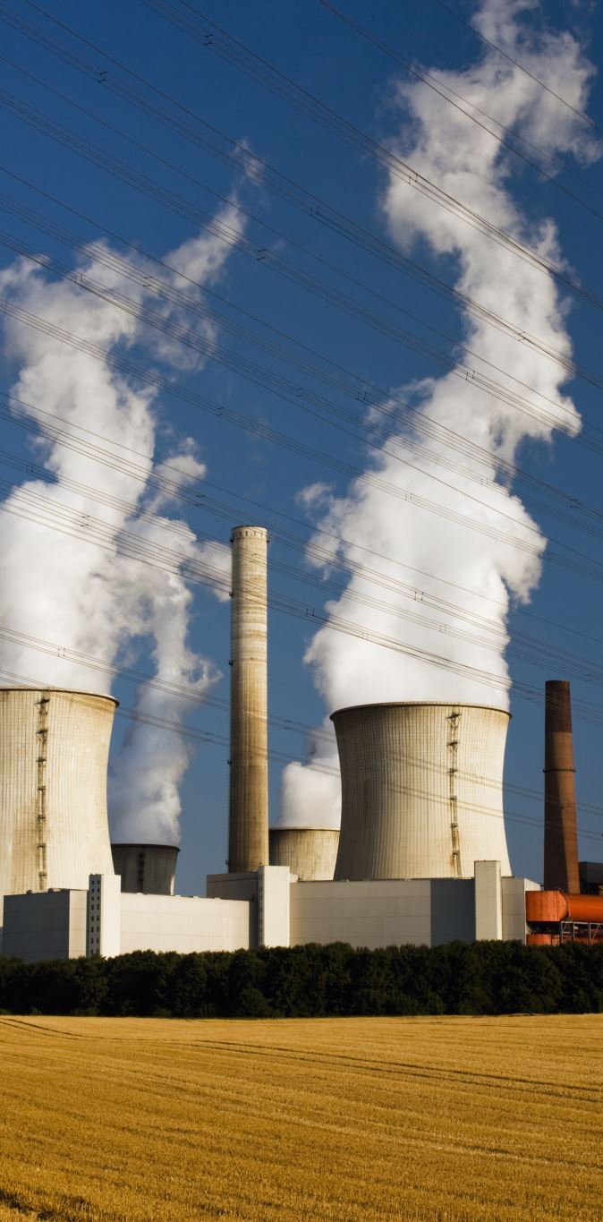
Introduction
India's energy landscape is at a critical juncture, balancing growing demands with environmental concerns and climate commitments. This report evaluates coal's dominance and nuclear energy's potential for a sustainable energy mix.

Slide 3
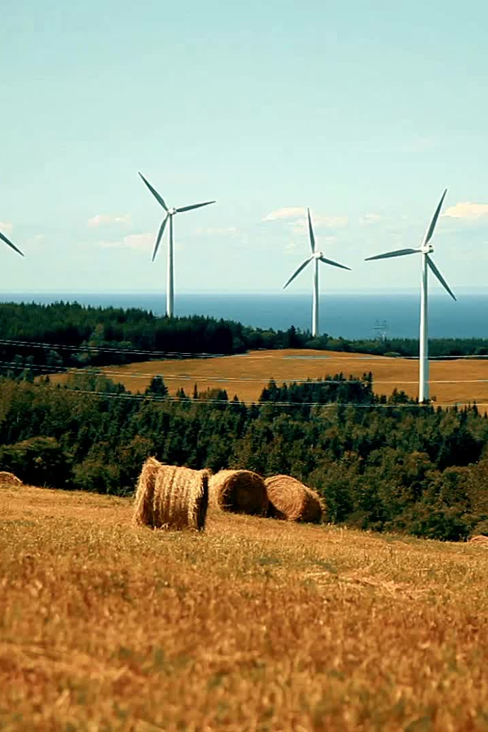
Key Metrics of Energy Landscape
Coal Energy:
- Contribution: ~71%
- Carbon Emissions: High
- Efficiency: ~33-35%
Nuclear Energy:
- Contribution: ~3-5%
- Carbon Emissions: Negligible
- Efficiency: ~80-90%

Slide 4
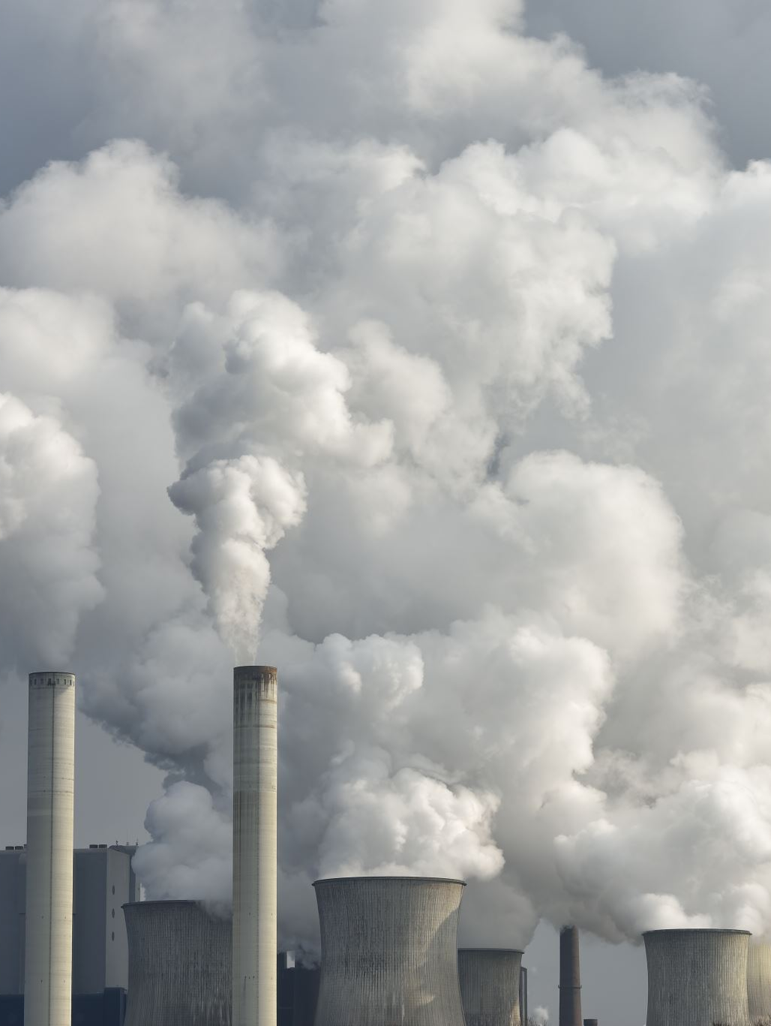
Environmental Impact Analysis
Coal-fired plants contribute ~50% of power sector CO2 emissions.
Nuclear power offers a low-emission alternative with minimal land and water requirements.

Slide 5
Economic Feasibility
Coal: Lower short-term costs (₹2.5-3.5/kWh) but high externalities.
Nuclear: High capital costs (₹10-15 crore/MW) but lower operational costs and longer plant lifespans.

Slide 6
Energy Production and Efficiency
Coal efficiency: ~33-35%, with PLF at ~55%.
Nuclear efficiency: ~90%, with PLF consistently above 80%.
A single uranium pellet produces energy equivalent to 1,000 kg of coal.

Slide 7
Scenario-Based Modeling
Baseline Scenario:
- Coal: ~50% by 2030
- Nuclear: ~8% by 2030
Accelerated Scenario:
- Coal: ~40% by 2030
- Nuclear: ~15% by 2030

Slide 8
Predictive and Prescriptive Modeling
Predictive Models:
- Forecast coal share declining to 50% by 2030.
- Nuclear share rising to ~15% with incentives.
Prescriptive Models:
- Optimize decommissioning of inefficient coal plants.
- Invest in modular nuclear reactors and hybrid systems.

Slide 9
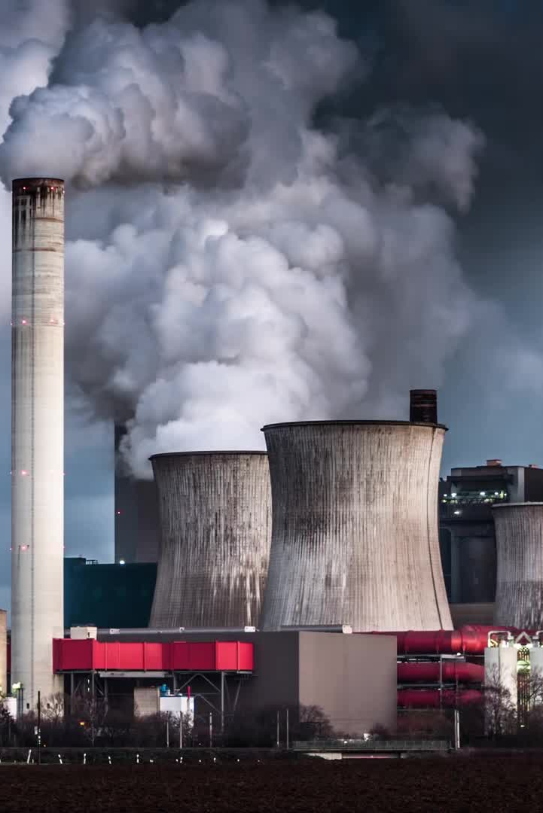
Conclusion
India’s energy future depends on a well-planned transition from coal to nuclear power. This requires phased decommissioning of coal plants, investment in nuclear technologies, and integration with renewables to ensure sustainability and grid reliability.

